Slide 1

Notes:
Hello. My name is _____________________________ and I am here representing The ERA-North Carolina Alliance.
Good evening-
My name is Judy Lotas and I’m here representing the League of Women Voters of Dare County.

Slide 2

IT’S
HIGH TIME
WE PASS THE
EQUAL RIGHTS
AMENDMENT
Notes:
The United States Constitution was signed 230 years ago—but it has yet to mention women!

Slide 3

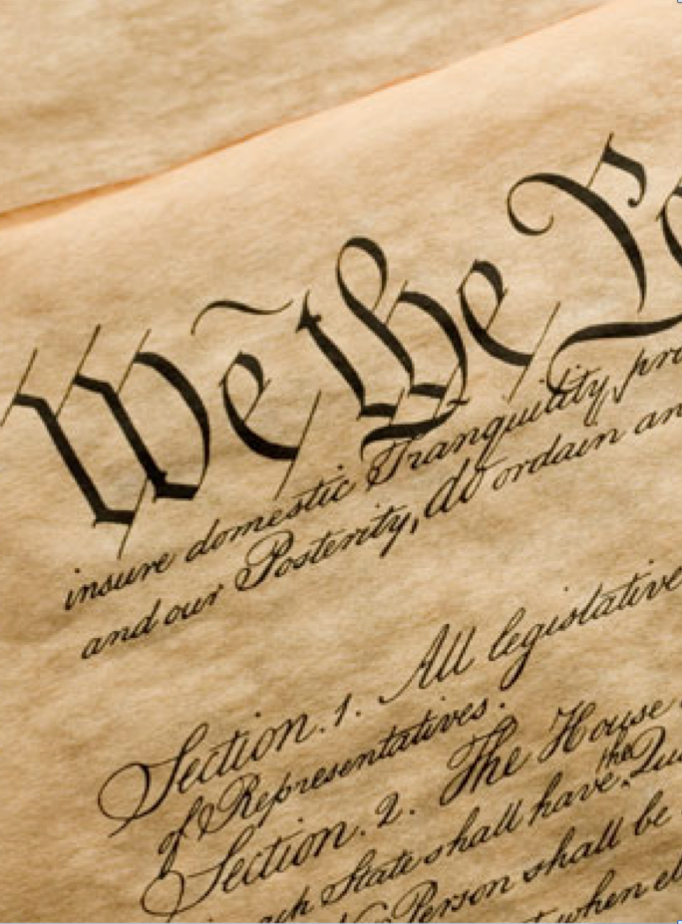
ERA
“Equality of rights
under the law shall
not be denied
or abridged by the
United States
or by any state
on account
of sex.”
Notes:
When we speak of the ERA we are not referencing detergents or baseball stats, but the proposed
Twenty-eighth Amendment to the Constitution, which says:
“Equality of rights under the law shall not be denied or abridged by the United States or by any state on account of sex.”

Slide 4

96%
of adults believe that male and female citizens should have equal rights
77%
believe the Constitution already
guarantees equal rights.
It doesn’t.
Notes:
As you can see, our country favors equality---
96% believe male and female citizens should have equal rights.
77% believe the Constitution already guarantees it.
We wish!

Slide 5


We won’t be the first to include women in the Constitution.
Japan 1947
Germany 1949
Russia 1993
Today
84%
of all Constitutions guarantee equal rights
Notes:
The American Constitution is the oldest in the world—but it has failed to include women!
The Japanese Constitution, drafted by General Douglas MacArthur…does.
The German “Basic Law”, influenced by General George Marshall…does.
The Russian Constitution, conceived in the Reagan era… does.
All contain specific language for the inclusion of women….as do 84% of all the world’s
Constitutions!

Slide 6


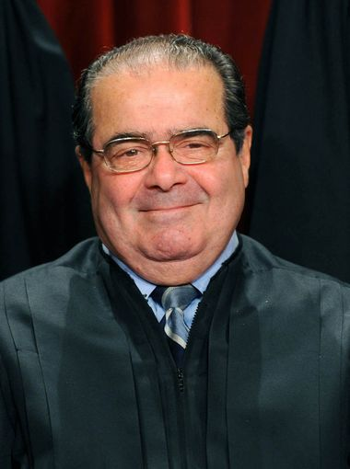
THE 14TH
AMENDMENT
“Certainly the Constitution does not require discrimination
on the basis of sex.
The only issue is whether it prohibits it.
It doesn’t.”
-Justice Antonin Scalia
Notes:
Many Americans contend that the Fourteenth Amendment protects women’s rights, but according to the late Justice Scalia, it does not.
He said, quote, “Certainly the Constitution does not require discrimination on the basis of sex. The only issue is whether it prohibits it. It doesn’t.
In fact, a strict interpretation of the Constitution would rule that women were not citizens until they got the vote in 1920…therefore, they were not even considered when the Fourteenth Amendment passed in 1868!

Slide 7
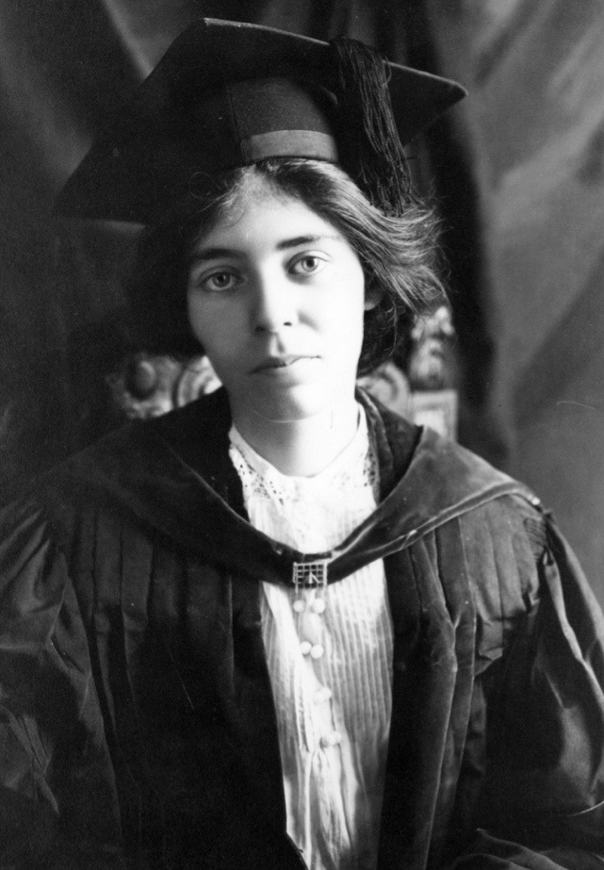
ERA TIMELINE
Alice Paul campaigns for ERA. Bill goes to Congress
Senate votes
1970
Seven year time limit imposed
Passes Congress, sent to states
22 states ratify ERA
1978
Deadline extended
1982
Fails ratification by 3 states
Notes:
Alice Paul started campaigning for the ERA in 1923, three years after women became voters.
She said “I never doubted that equal rights was the right direction. Most reforms---most problems—are complicated. But to me there is nothing complicated about ordinary equality.”
How can we not agree??

Slide 8

WHERE
COULD
ERA
HELP
TODAY?
Notes:
Just on its face, passing ERA seems the obvious fair thing to do.
But how, specifically, might passage of ERA help women and families today?

Slide 9


70% of America’s poor
are women and
the children
who depend on them
HELP
WOMEN AND
CHILDREN
IN
POVERTY
Notes:
It would no doubt help address women and children living in poverty.
Economic analyses by the World Bank, United Nations and Goldman Sachs demonstrate a significant statistical correlation between gender equality and the level of development of countries.
Multiple studies have shown that what is good for women is good for nations, neighborhoods, and families.

Slide 10


HELP
VICTIMS OF
DOMESTIC
VIOLENCE
• Ensure that domestic violence be given same importance as stranger assault
• Ensure the legal rights in Title IX
Notes:
It would help victims of domestic violence receive justice.
According to the Supreme Court, enforcing domestic violence restraining orders isn’t required, but left to police discretion. The ERA would assure that police could not give domestic violence less importance than stranger assault because the victims are predominantly women.
Currently, the federal government is investigating 147 colleges and universities for failing to protect students under Title IX provisions. The ERA would insure the legal rights in Title IX.

Slide 11


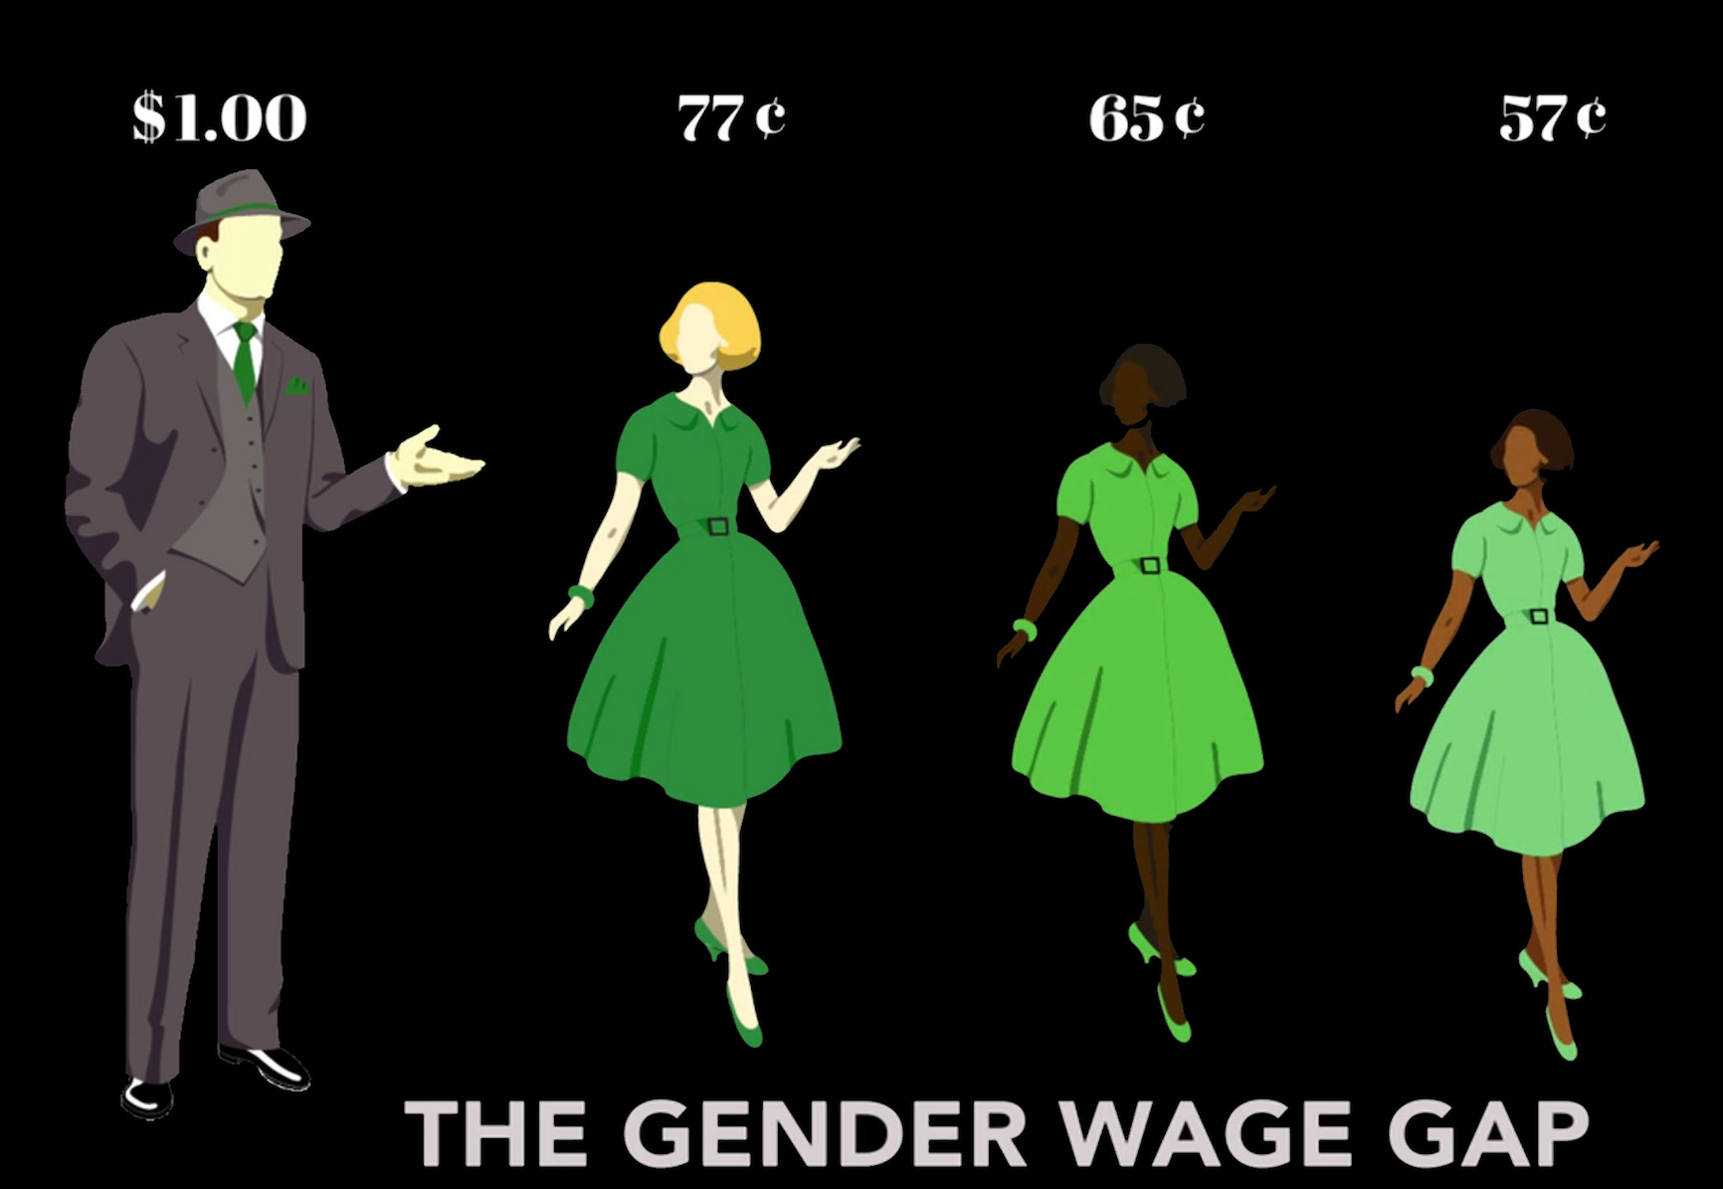
HELP
ELIMINATE
PAY
INEQUALITY
Notes:
It would help eliminate pay inequality.
Women still earn something like 77¢ to a man’s dollar.
That comparison of disparate pay for equal work has hardly budged in 30 years!

Slide 12

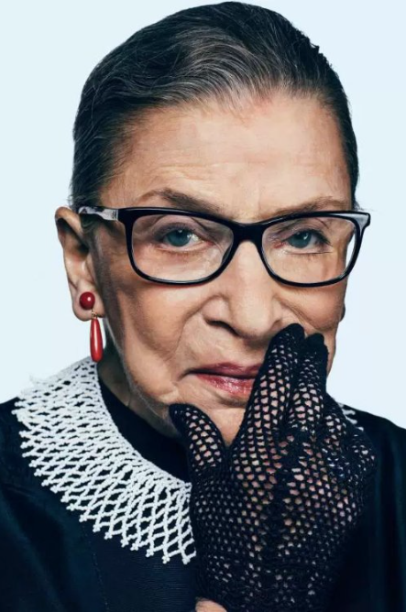
Justice Ruth Bader Ginsburg
At the National Press Club:
“If I could choose an amendment to add to the Constitution, it would be the Equal Rights Amendment.
I would like my granddaughters, when they pick up the Constitution, to see that notion---that women and men are persons of equal stature—I’d like them to see that is a basic principle of our society.”
Notes:
Justice Ruth Bader Ginsburg made this statement at the National Press Club in Washington DC:
“If I could choose an amendment to add to the Constitution, it would be the Equal Rights Amendment.
I would like my granddaughters when they pick up the Constitution, to see that notion—that women and men are persons of equal stature—I’d like them to see that is a basic principle of our society.”
Yes.

Slide 13


ERA IN NC
Sen. Floyd McKissick
and
Rep. Carla Cunningham
will introduce
ERA bill
in 2017 session of GA
THIS IS WHY
YOUR RESOLUTION
IS SO IMPORTANT!
Notes:
Here at home, the ERA was defeated.
Again. And again.
In 1977 it came this close to passage….then Phyllis Schlafly scared people with guess what: shared bathrooms.
On Feb 14, Valentine’s Day, Senator Lloyd McKissick and Representative Carla Cunningham are going to introduce the ERA bill in the General Assembly.
We can pass it. All we have to do is ALL speak up.

Slide 14



We hope the Town of Duck will issue a resolution in support of the
Equal Rights
Amendment.
We will present it to the
General Assembly in Raleigh with pride and determination.
Thank you!
Notes:
That’s why it’s so important that we let Raleigh know where we, the people, stand. Please issue a Resolution in support of ERA,
from the town of Duck, in the Outer Banks, the Land of Beginnings.
Thank you very much.

